Slide 1
Suricata ELK 安裝步驟 智慧資安三 410580121 余浩維
2023.10.04

Slide 2
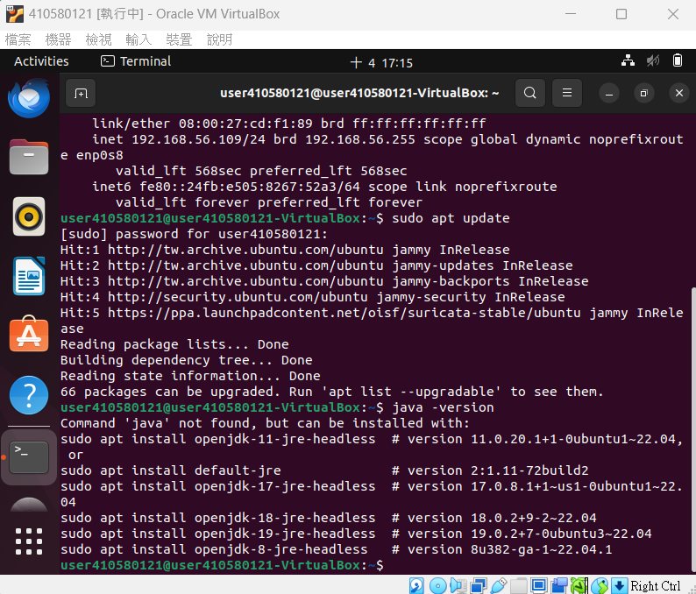
$ sudo apt update $ java -version # To install the OpenJDK version of java, first update your apt package index

Slide 3
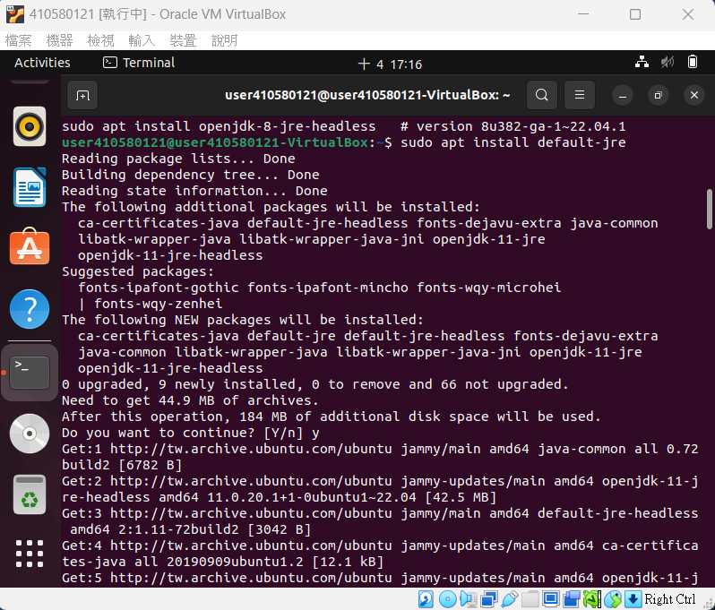
$ sudo apt install default-jre # Execute the following command to install the JRE from OpenJDK 11

Slide 4
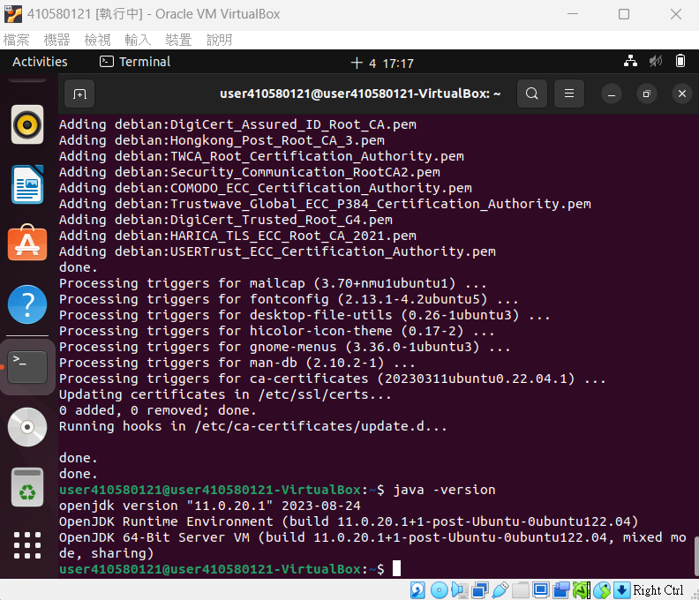
$ java -version # Verify the installation

Slide 5
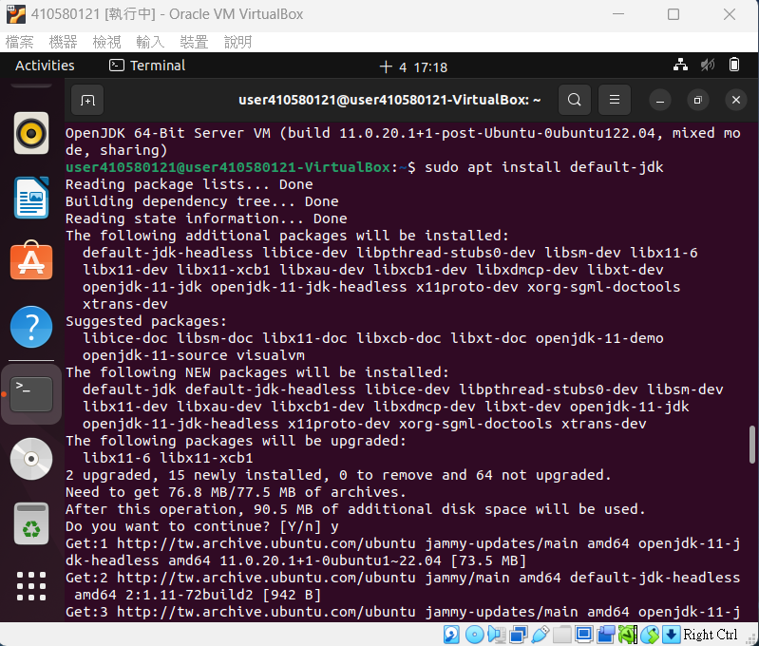
$ sudo apt install default-jdk # You may need the JDK in addition to the JRE in order to compile and run some specific Java-based software

Slide 6
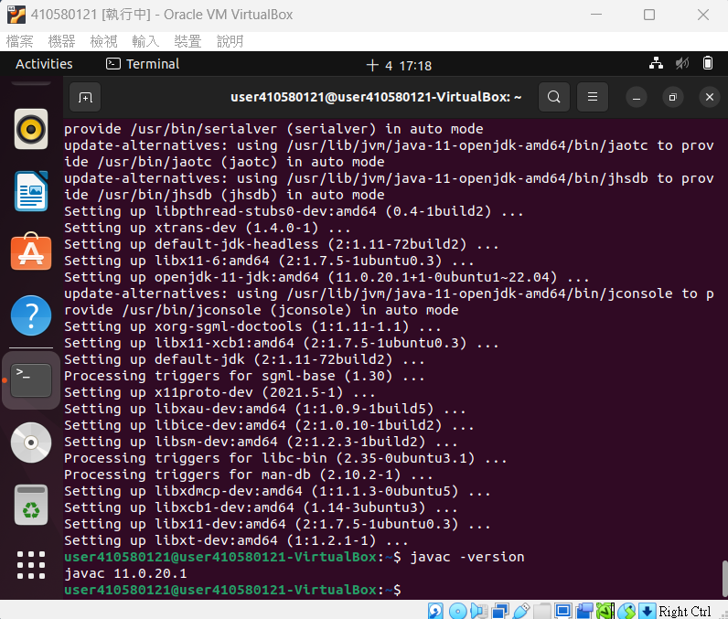
$ javac -version # Verify the installation

Slide 7
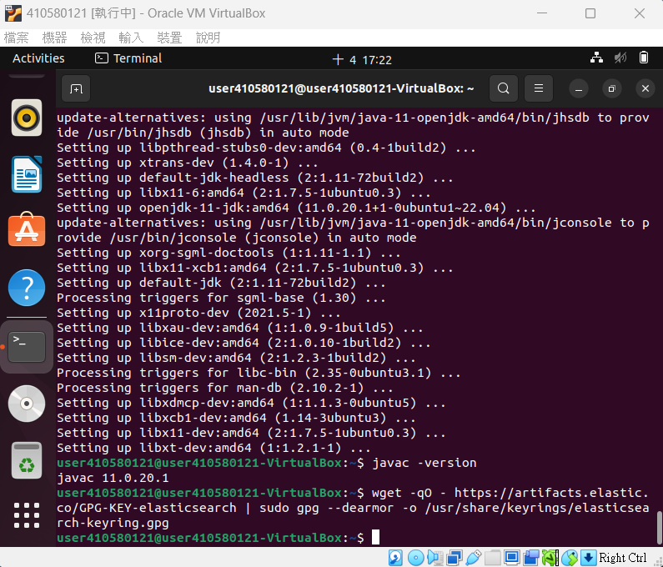
$ wget -qO - https://artifacts.elastic.co/GPG-KEY-elasticsearch | sudo gpg -- dearmor -o /usr/share/keyrings/elasticsearch-keyring.gpg # Download and install the public signing key

Slide 8
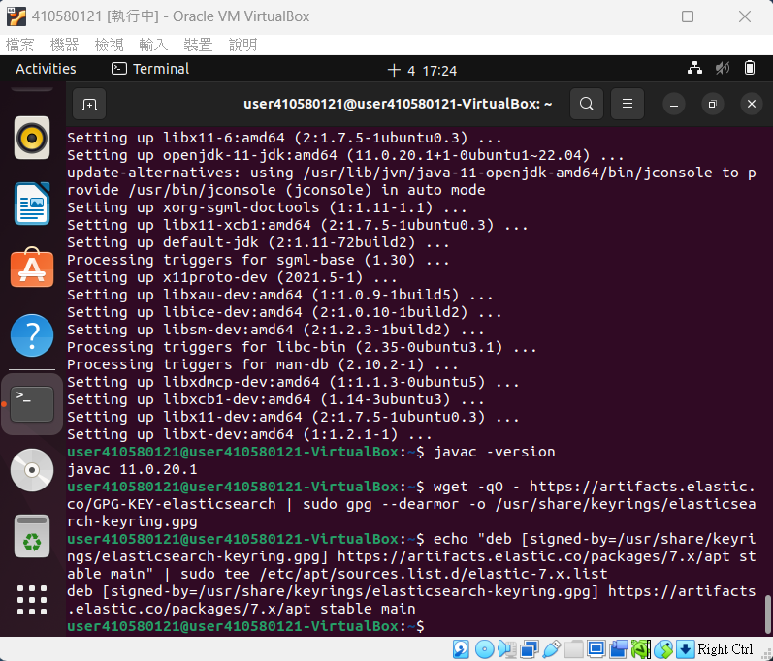
$ echo “deb [signed-by=/usr/share/keyrings/elasticsearch-keyring.gpg] https://artifacts.elastic.co/packages/7.x/apt stable main” | sudo tee /etc/apt/sources.list.d/elastic-7.x.list # 加入 Elasticsearch 套件來源

Slide 9
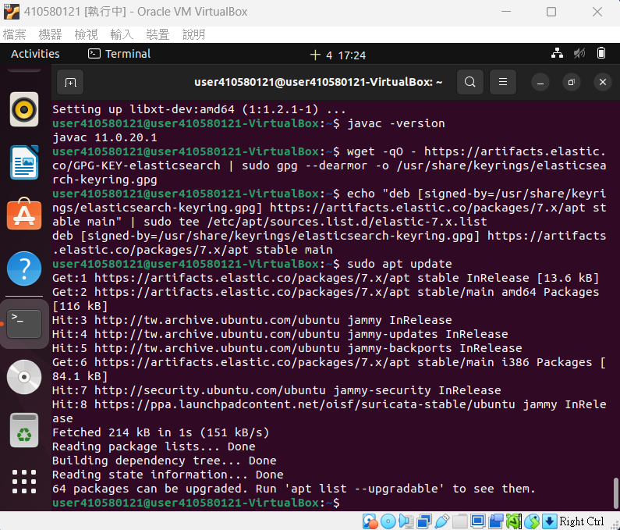
$ sudo apt update # 更新套件資料庫

Slide 10
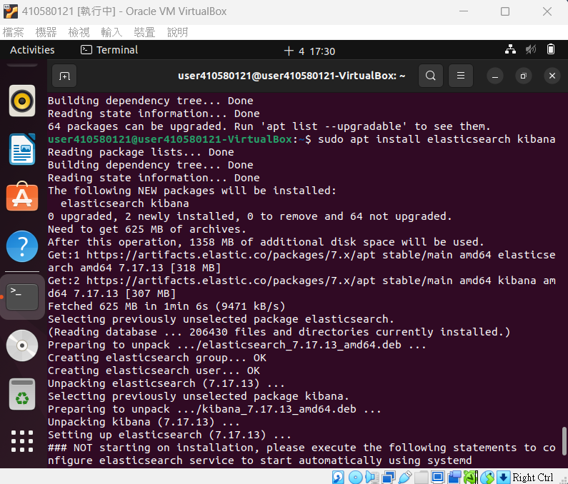
$ sudo apt install elasticsearch kibana #安裝 Elasticsearch & Kibana

Slide 11
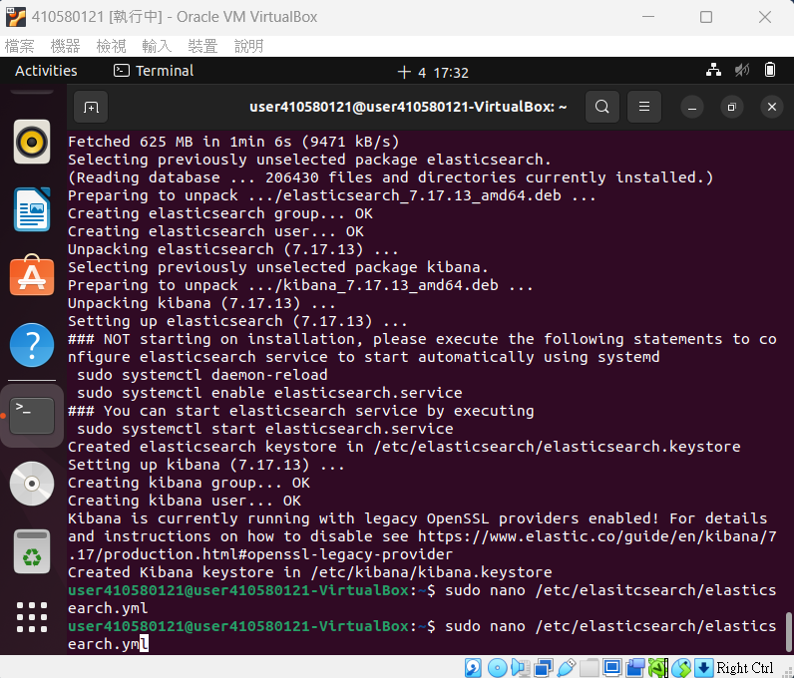
$ sudo nano /etc/elasticsearch/elasticsearch.yml

Slide 12
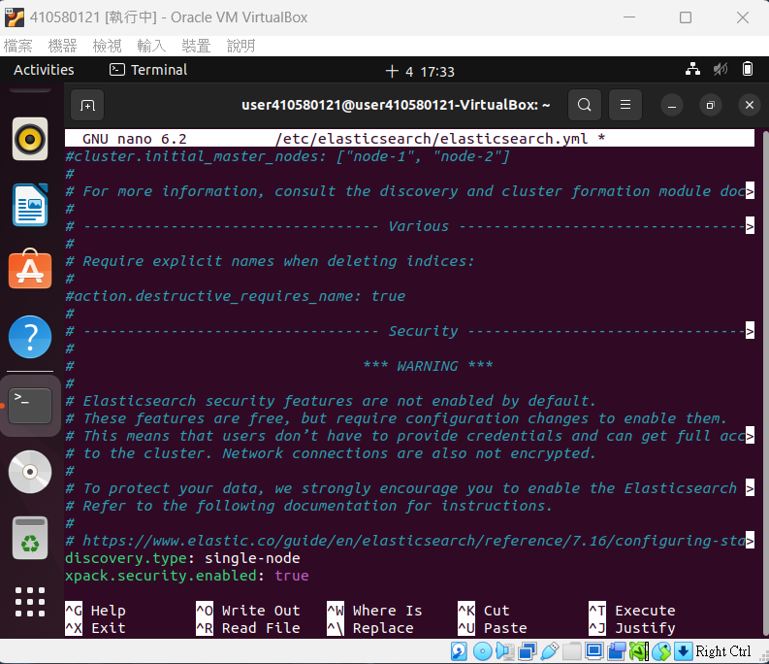
discovery.type: single-node; xpack.security.enabled:true # 移動至檔案最底部加入

Slide 13
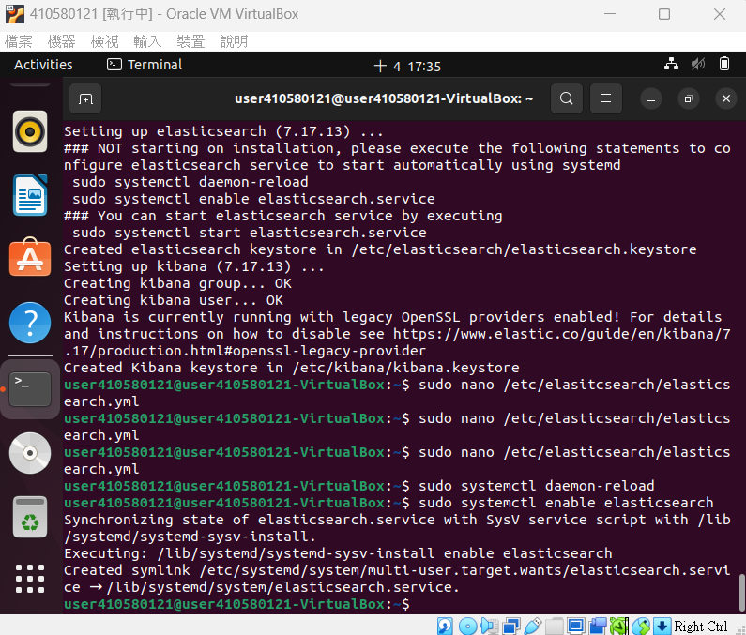
$ sudo systemctl daemon-reload $ sudo systemctl enable elasticsearch # 重新加載某個服務的配置文件，如果新安裝了一個服務，歸屬於 systemctl 管理，要是新服務的服務程序配置文件生效，需要重新加載。 #運行以下命令以使 Elasticsearch 在每次服務器啟動時啟動

Slide 14
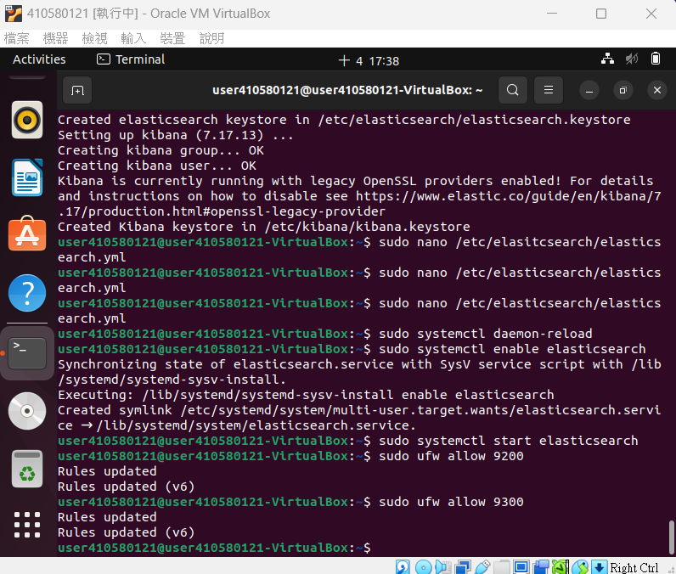
$ sudo systemctl start elasticsearch $ sudo ufw allow 9200 & 9300 # 啟動 Elasticsearch 服務 systemctl # Enable access to port 9200 from the local firewall

Slide 15
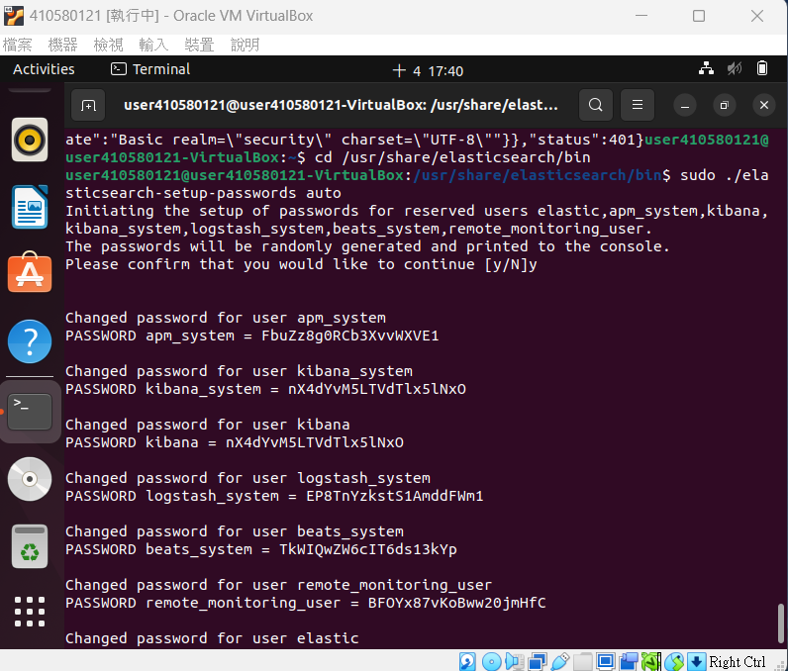
$ cd /usr/share/elasticsearch/bin $ sudo ./elasticsearch-setup-passwords auto # 將產生的密碼複製並儲存

Slide 16
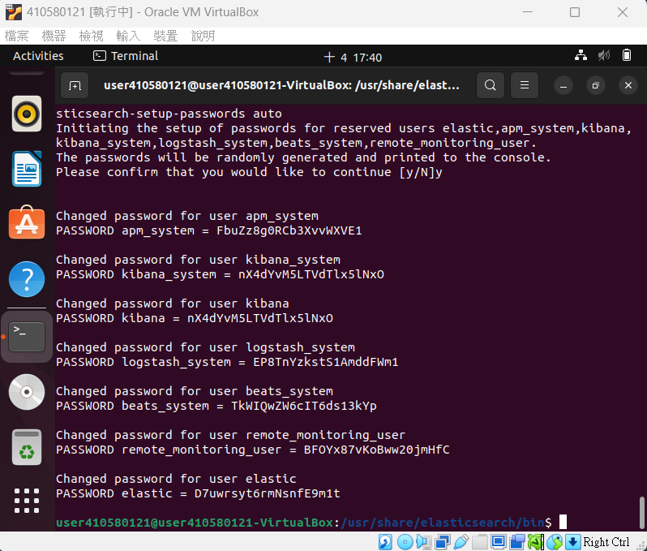

Slide 17
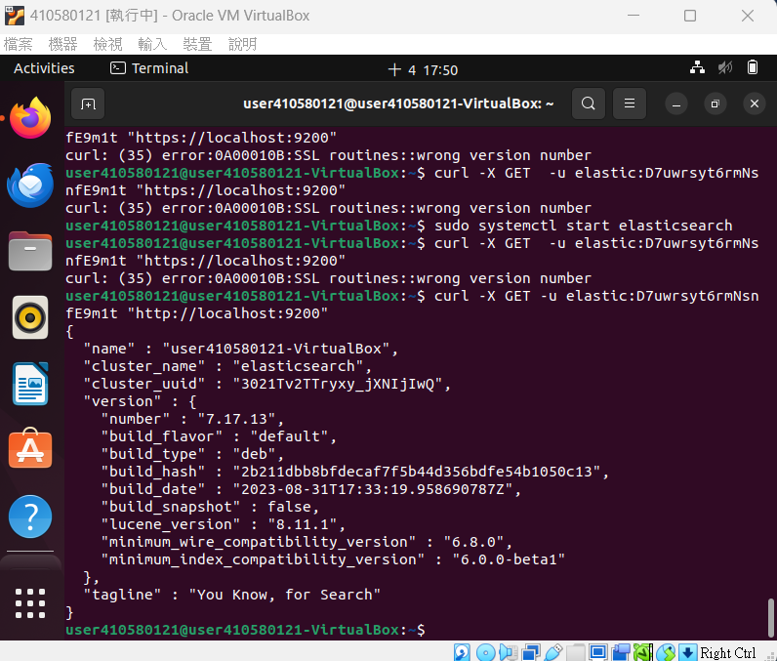
$ curl -X GET -u elastic:elastic password “http://localhost:9200”

Slide 18
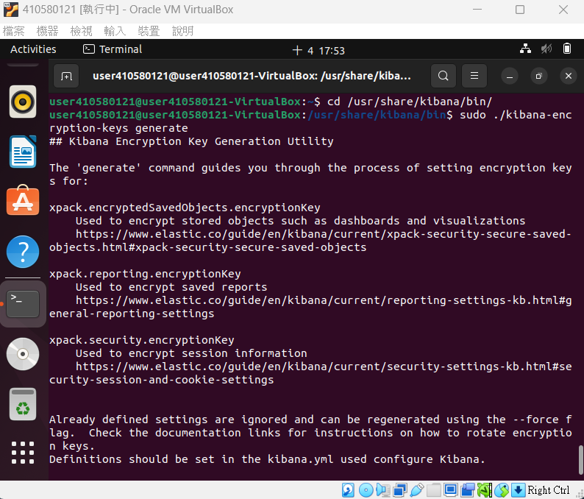
$ cd /usr/share/kibana/bin/ $ sudo ./kibana-encryption-keys generate # 將產生的密碼複製並儲存

Slide 19
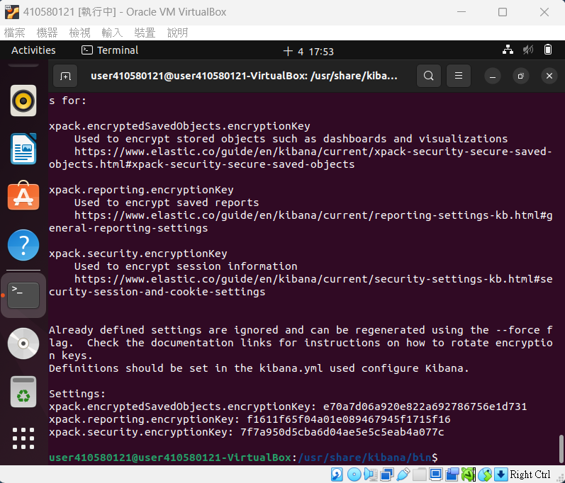

Slide 20
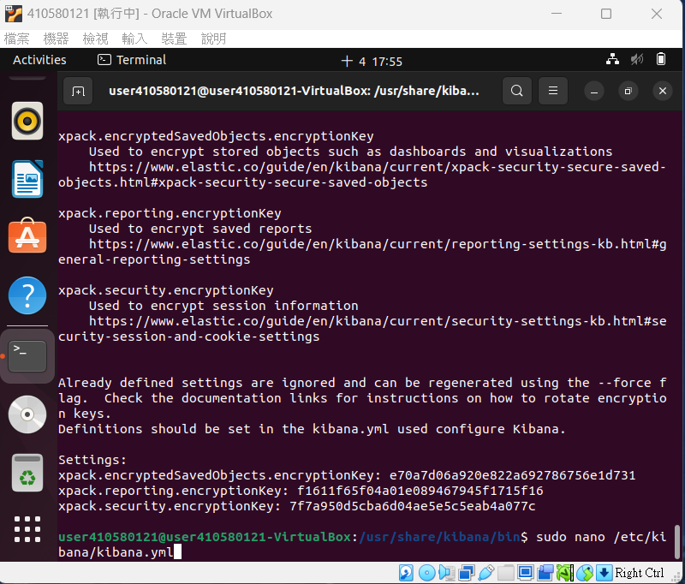
$ sudo nano /etc/kibana/kibana.yml

Slide 21
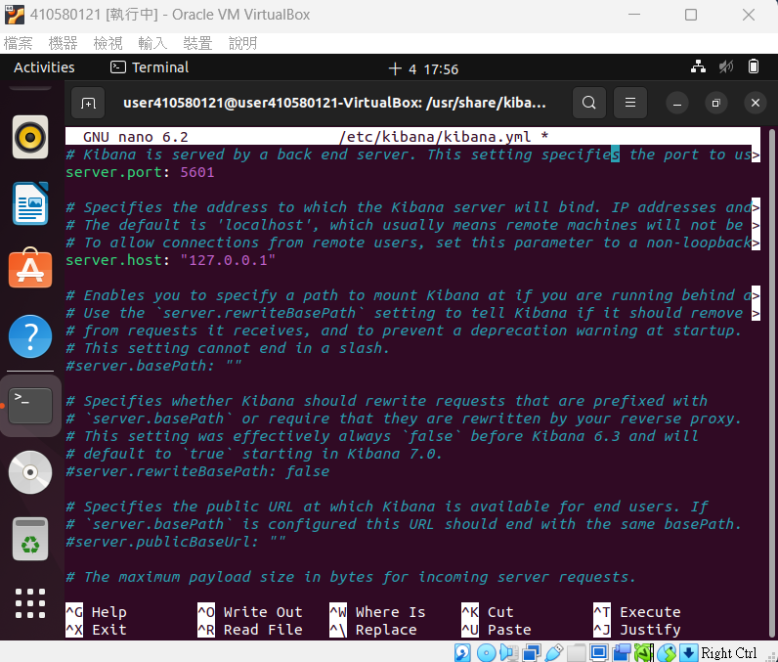
# 找到 server.port: 5601 並將註解拿掉 # 找到 server.host: “localhost” 將註解拿掉，並將 localhost 改為 0.0.0.0 (這邊是用 127.0.0.1 也可)

Slide 22
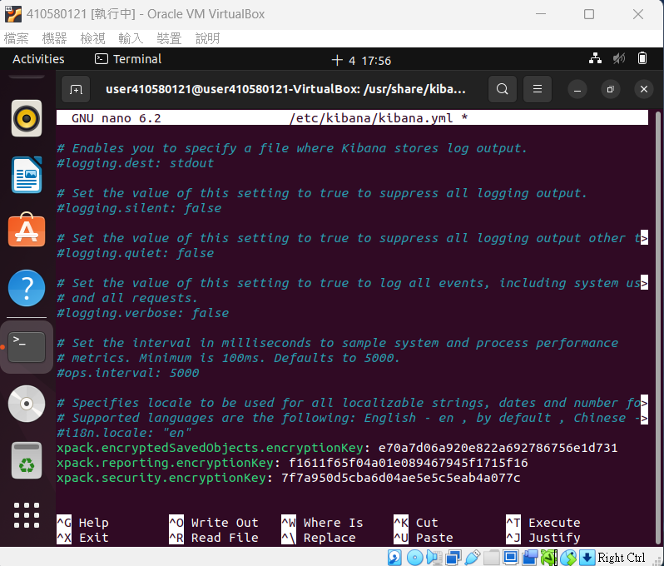
# 編輯設定檔並將剛剛的金鑰附加到最後一行

Slide 23
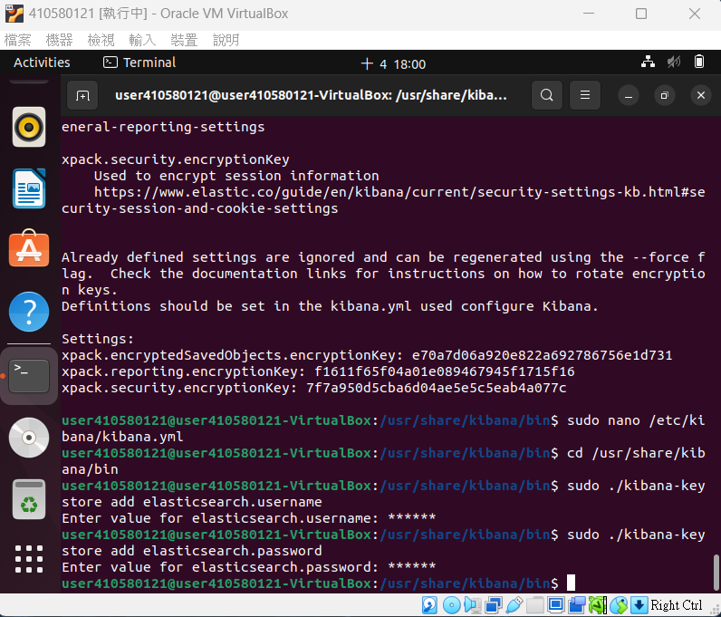
$ cd /usr/share/kibana/bin $ sudo ./kibana-keystore add elasticsearch.username
$ sudo ./kibana-keystore add elasticsearch.password
# 將 elasticsearch 密碼加入 kibana

Slide 24
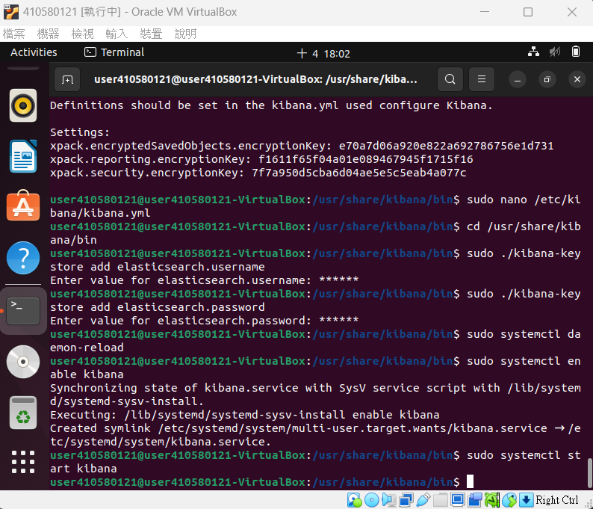
Kibana 啟用

Slide 25
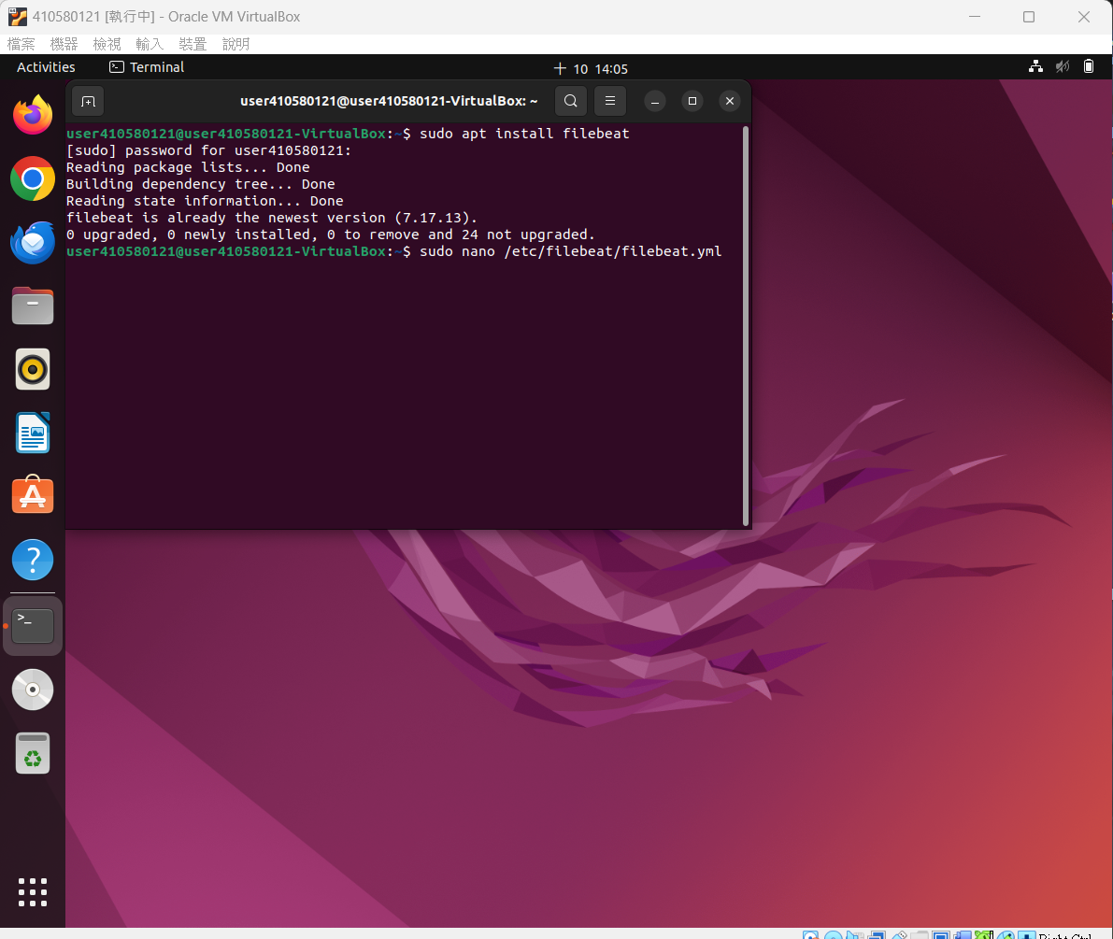
$ sudo apt install filebeat $ sudo nano /etc/filebeat/filebeat.yml
# 安裝 Filebeat
# 修改設定檔

Slide 26
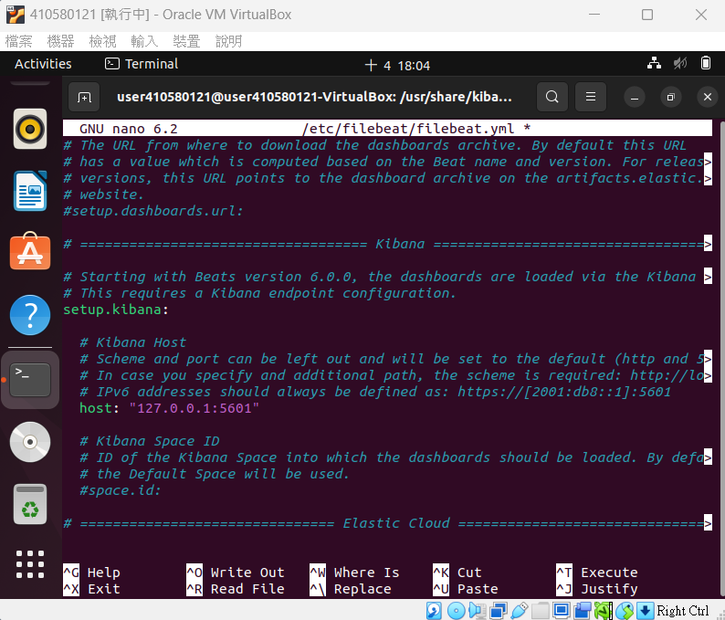
# 找到 setup.kibana: 下有 host: “localhost:5601”
# 拿掉註解並將 localhost:5601 改為 127.0.0.1:5601

Slide 27
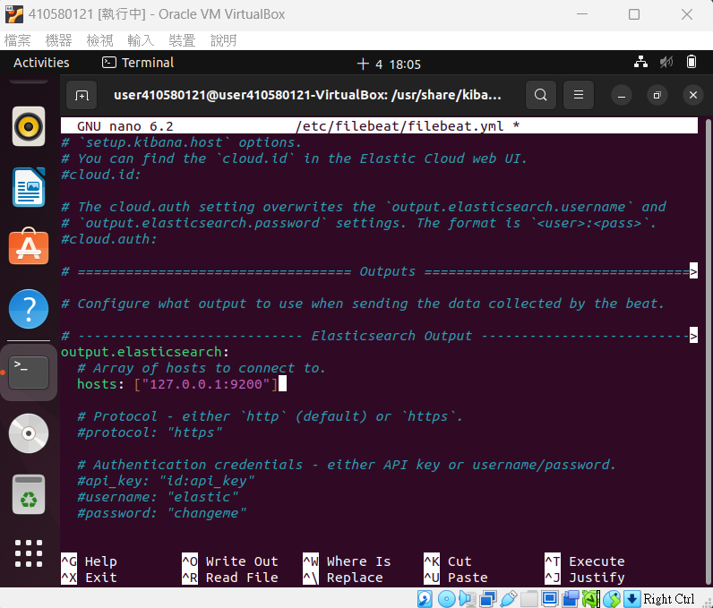
# 找到 output.elasticsearch: 下有 host: 改為 127.0.0.1:9200

Slide 28
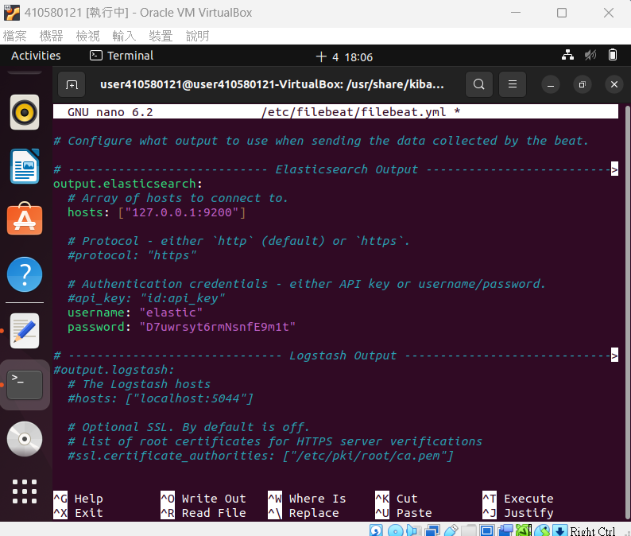
# 找到 username 將帳號改為 elastic
# 找到 password 將密碼改為 elasticsearch-setup-password 所產生的 elastic 的帳密

Slide 29
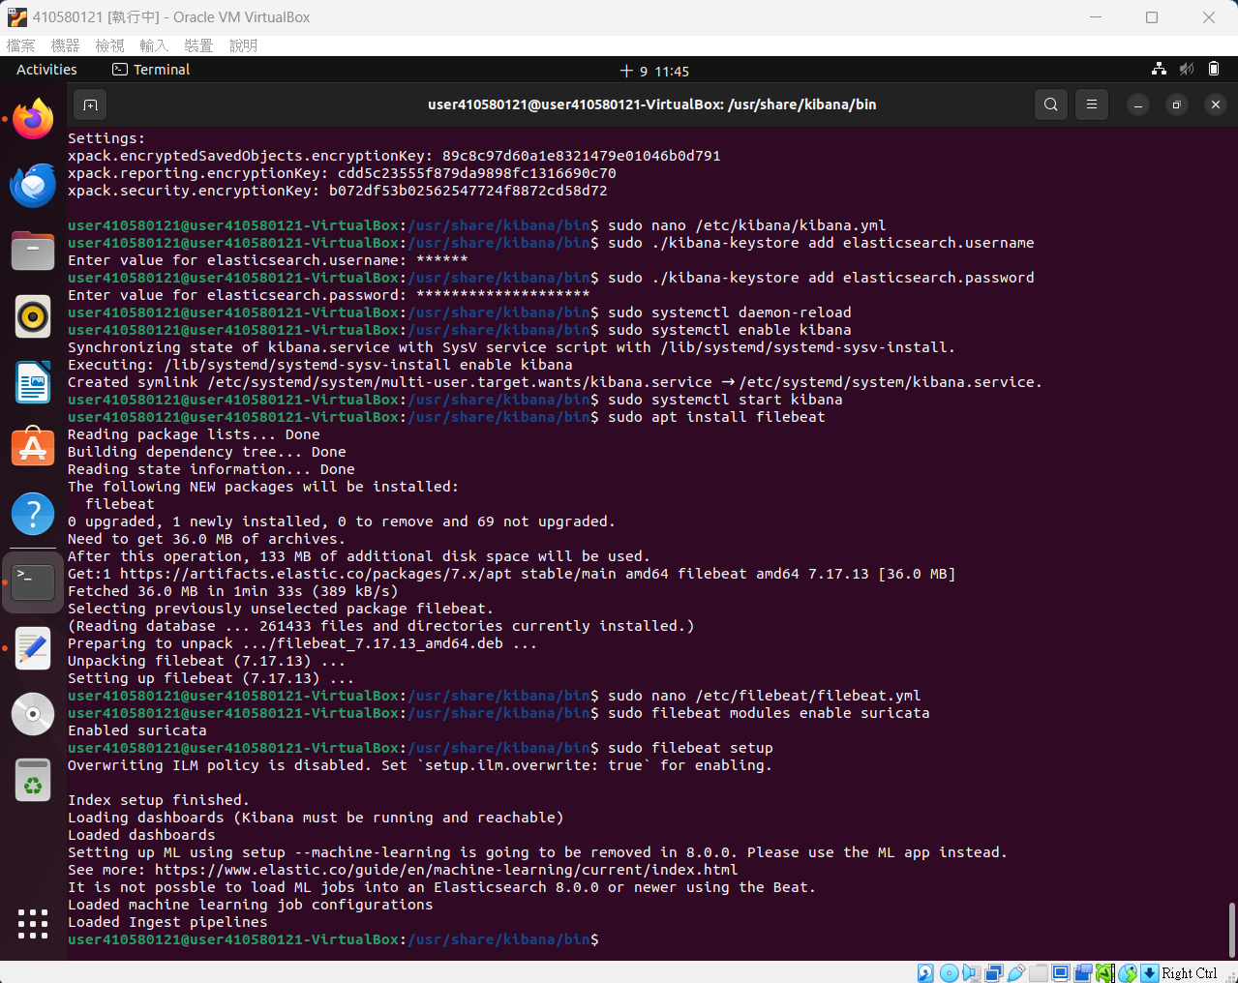
$ sudo filebeat modules enable suricata $ sudo filebeat setup
# 啟用 suricata 模組
# 加入 pipeline

Slide 30
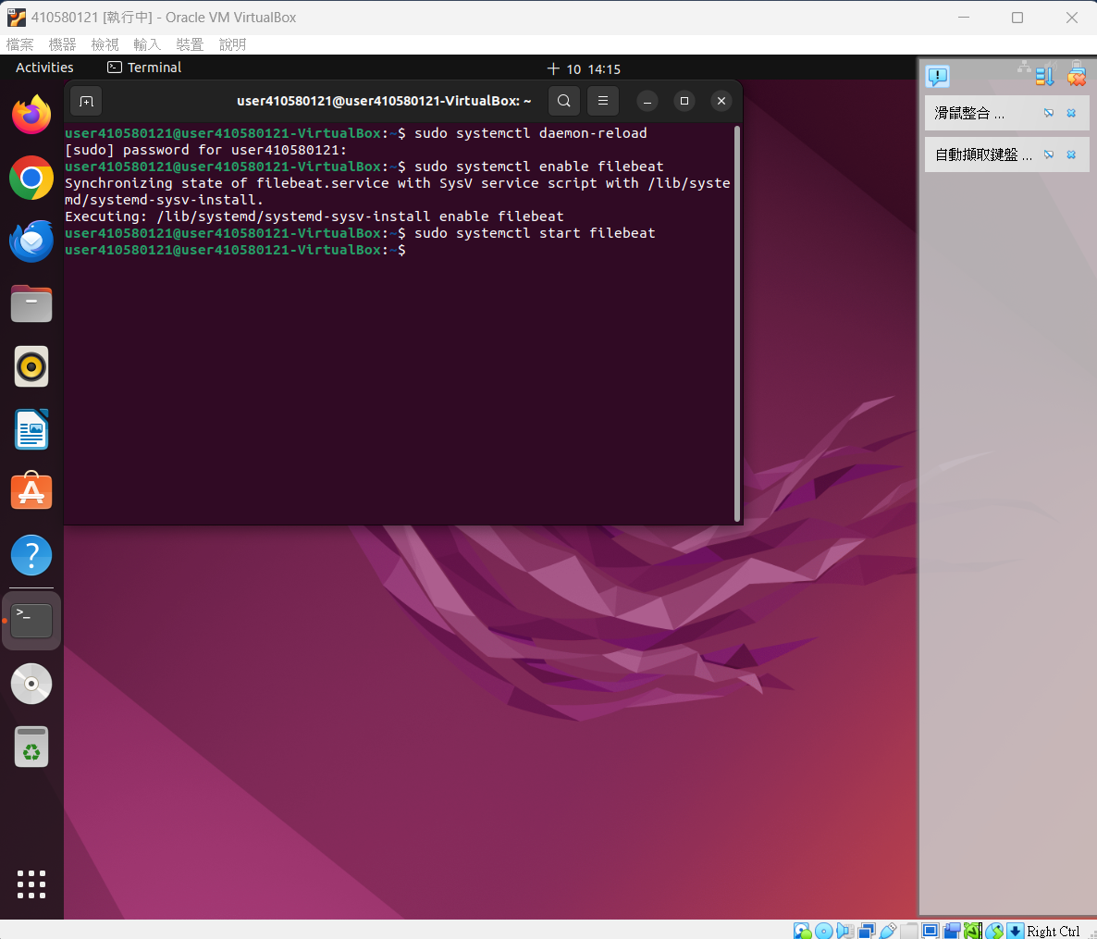
$ sudo systemctl daemon-reload $ sudo systemctl enable filebeat $ sudo systemctl start filebeat

Slide 31
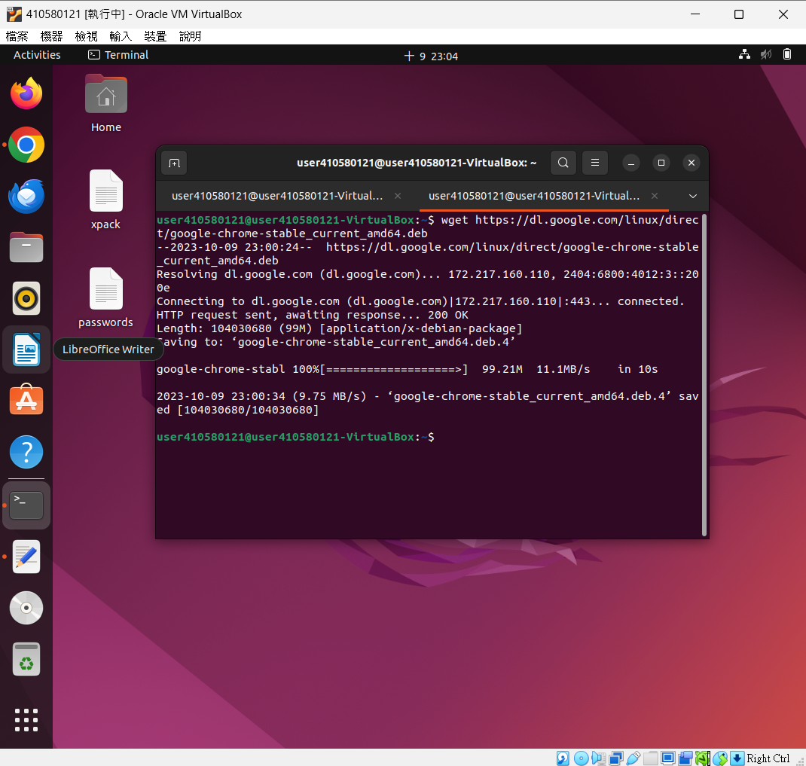
$ wget https://dl.google.com/linux/direct/google-chrome-stable_amd64.deb
# 下載 Google Chrome

Slide 32
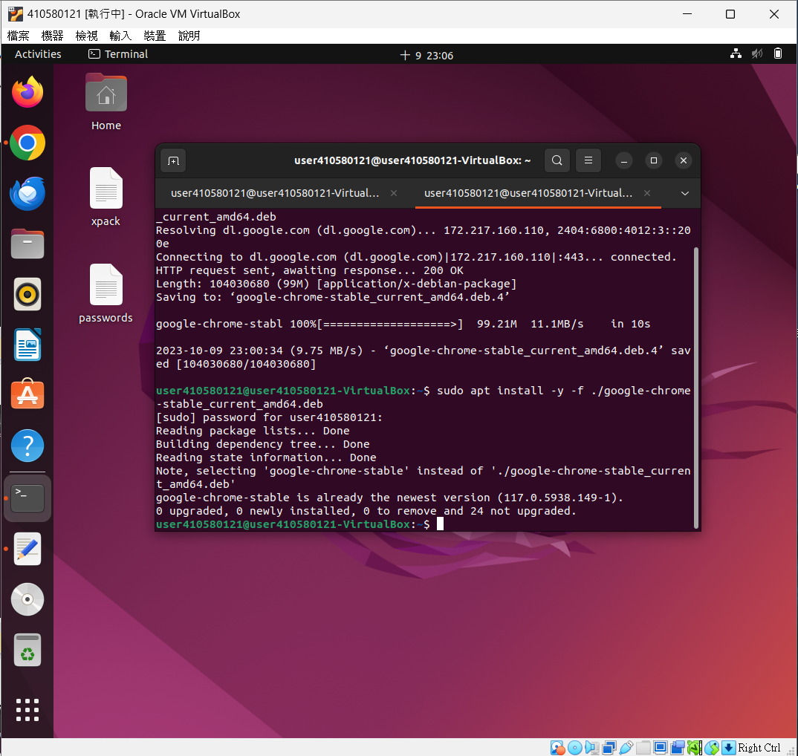
$ sudo apt install -y –f ./google-chrome-stable_amd64.deb
# 安裝 Google Chrome

Slide 33
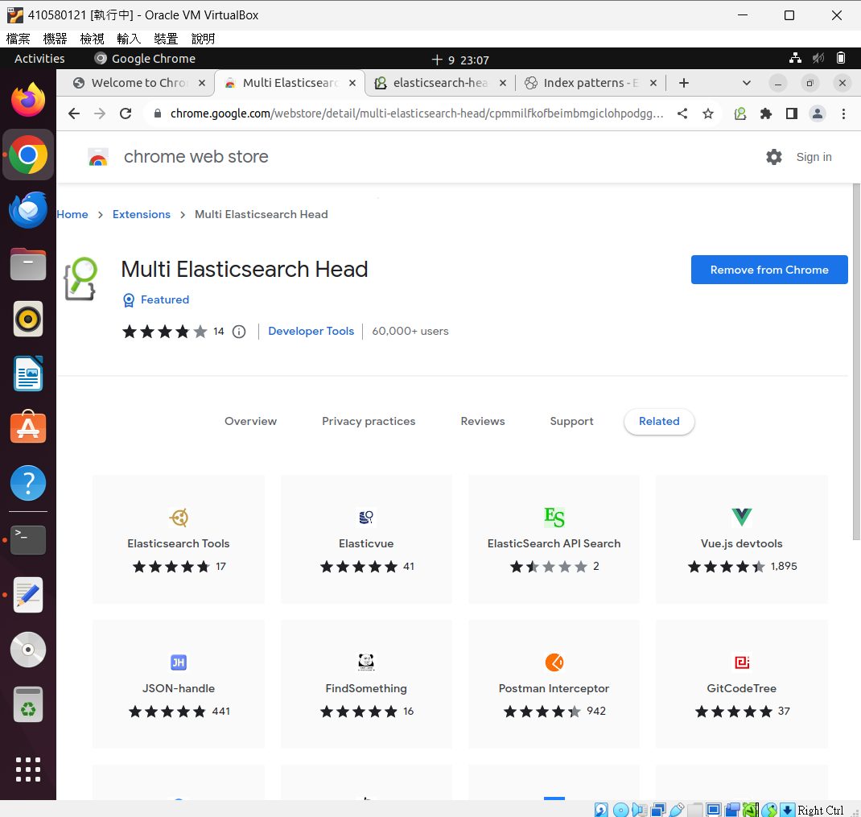

Slide 34
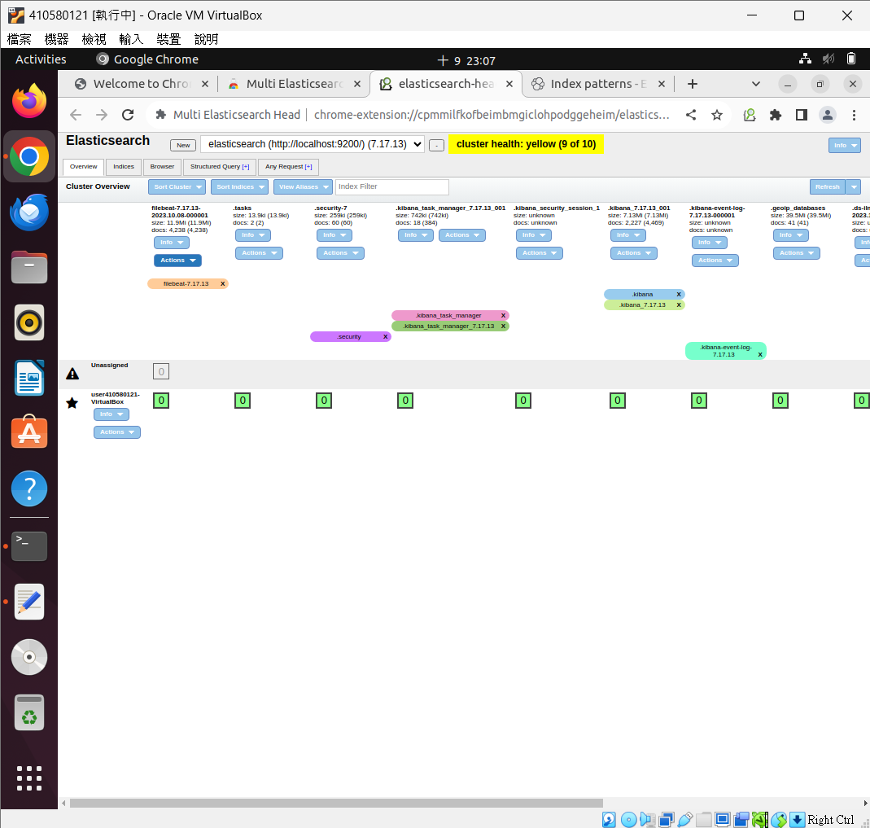

Slide 35
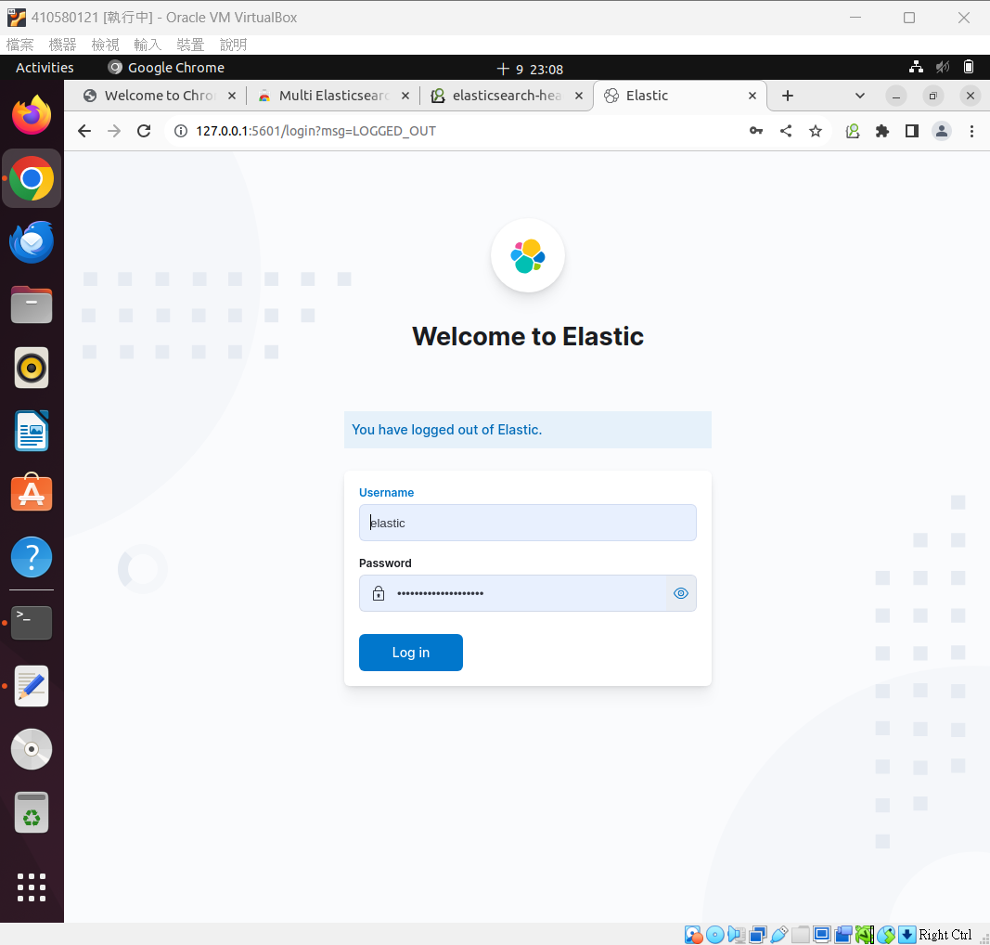
進入 kibana 介面
http://127.0.0.1:5601/

Slide 36
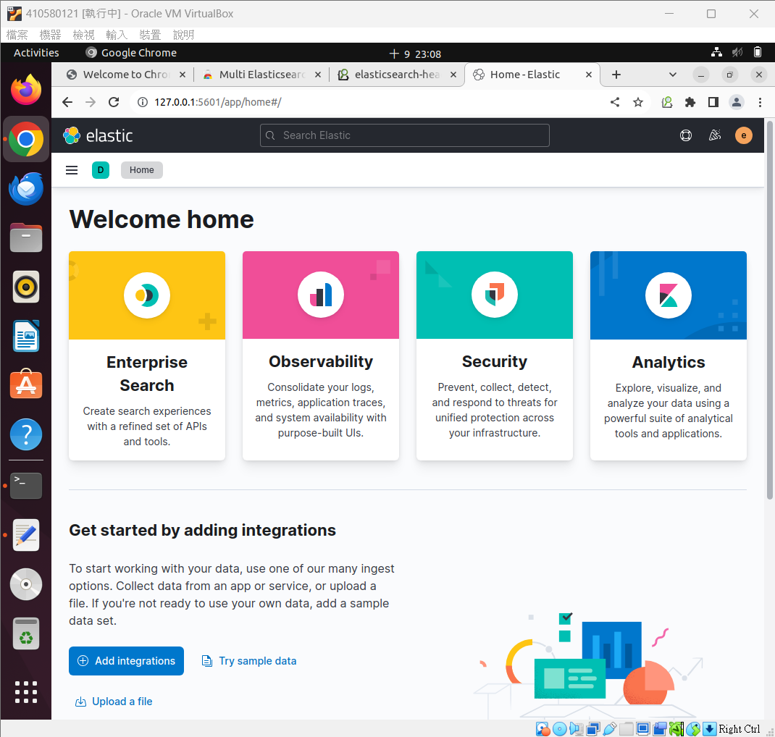

Slide 37
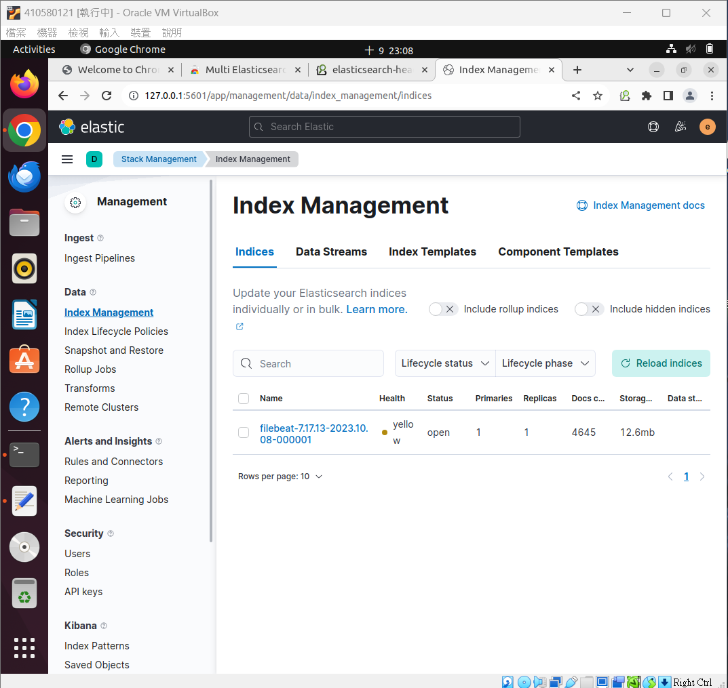
Kibana 操作

Slide 38
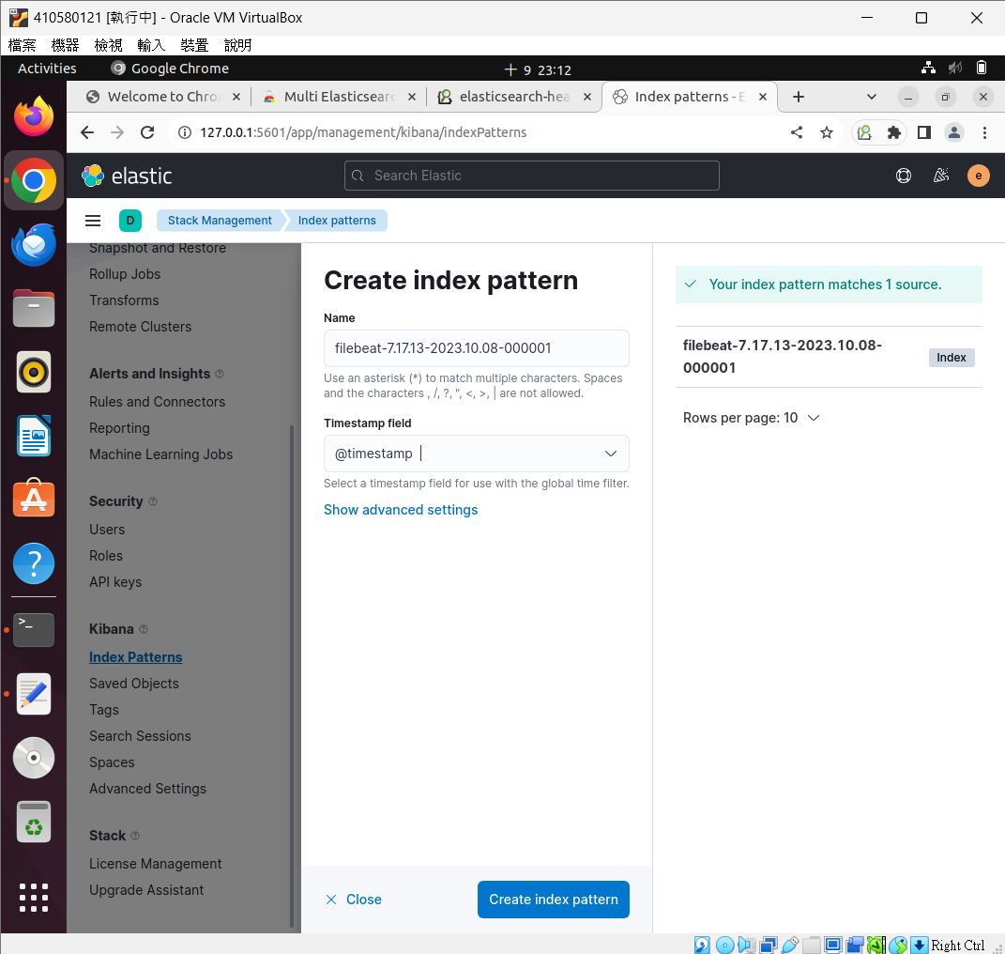

Slide 39
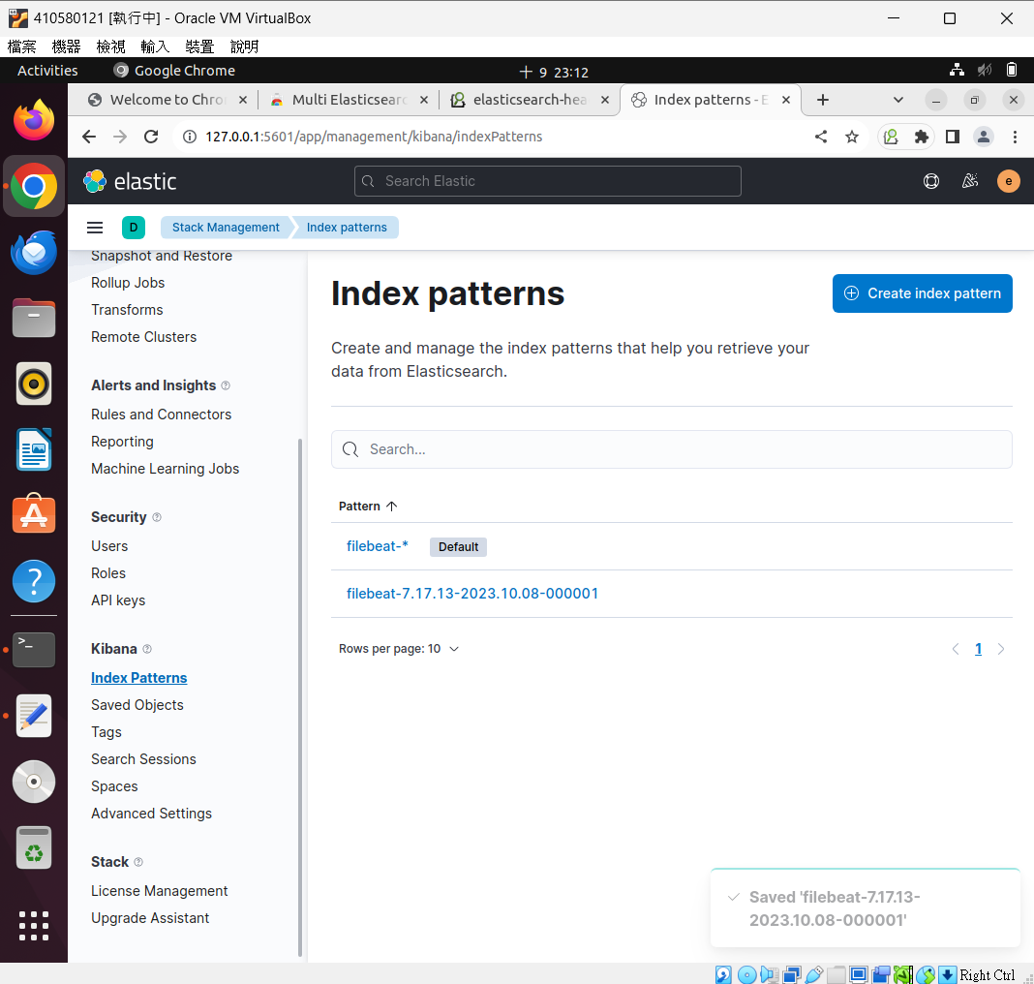

Slide 40
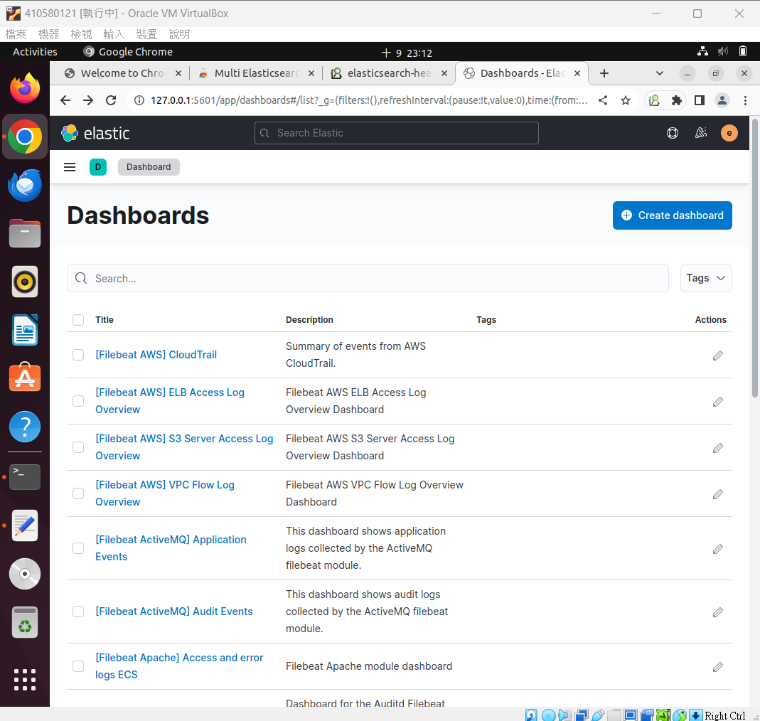

Slide 41
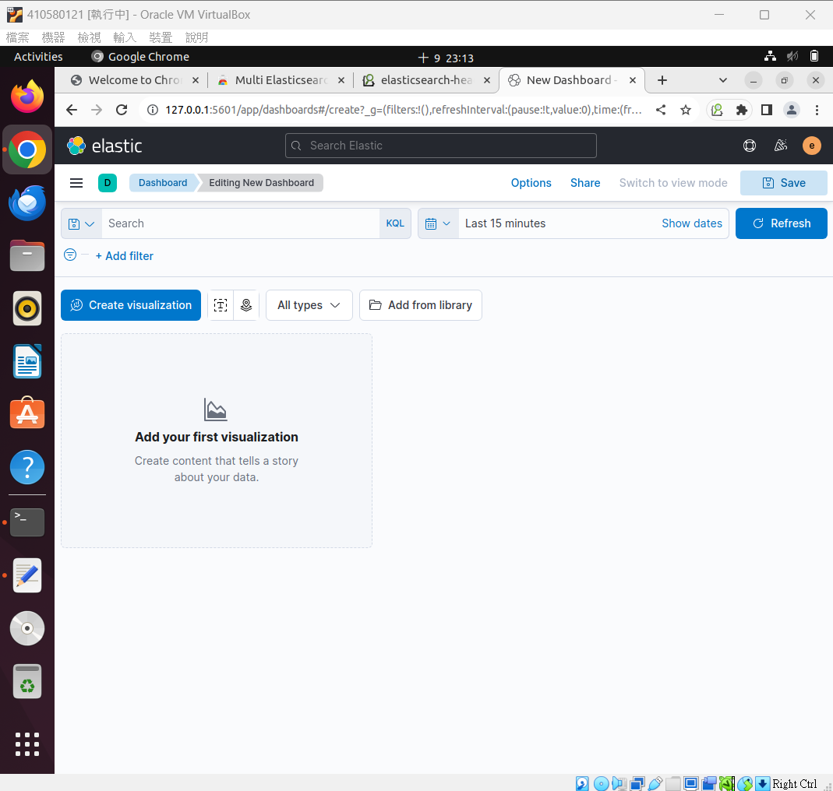

Slide 42
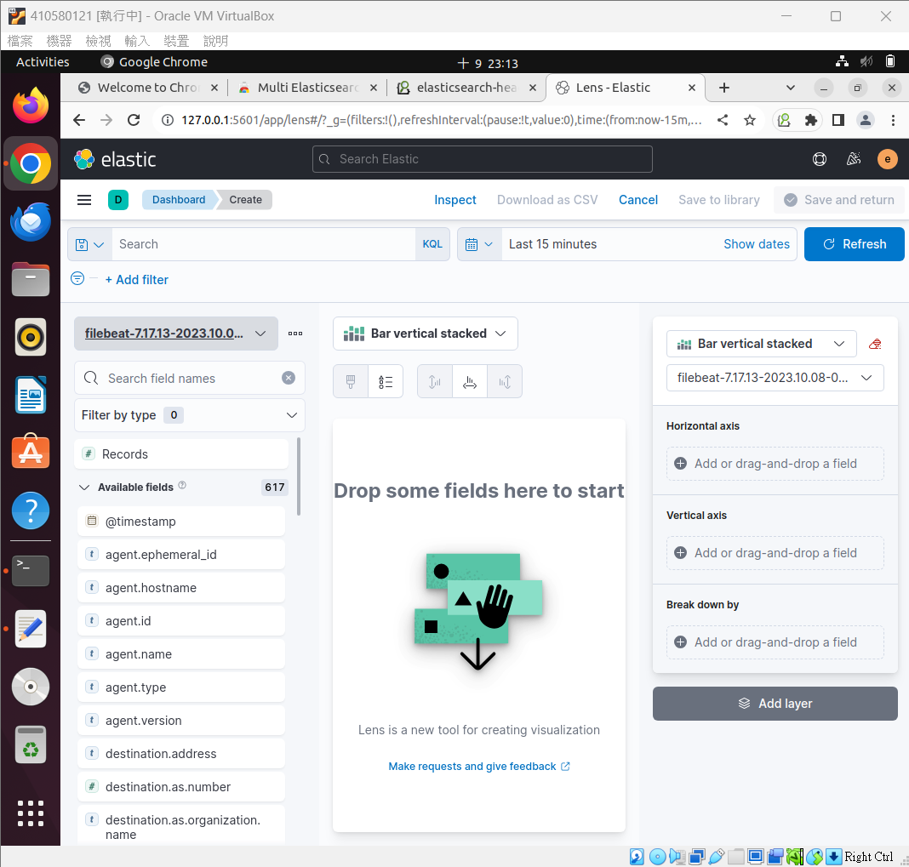

Slide 43
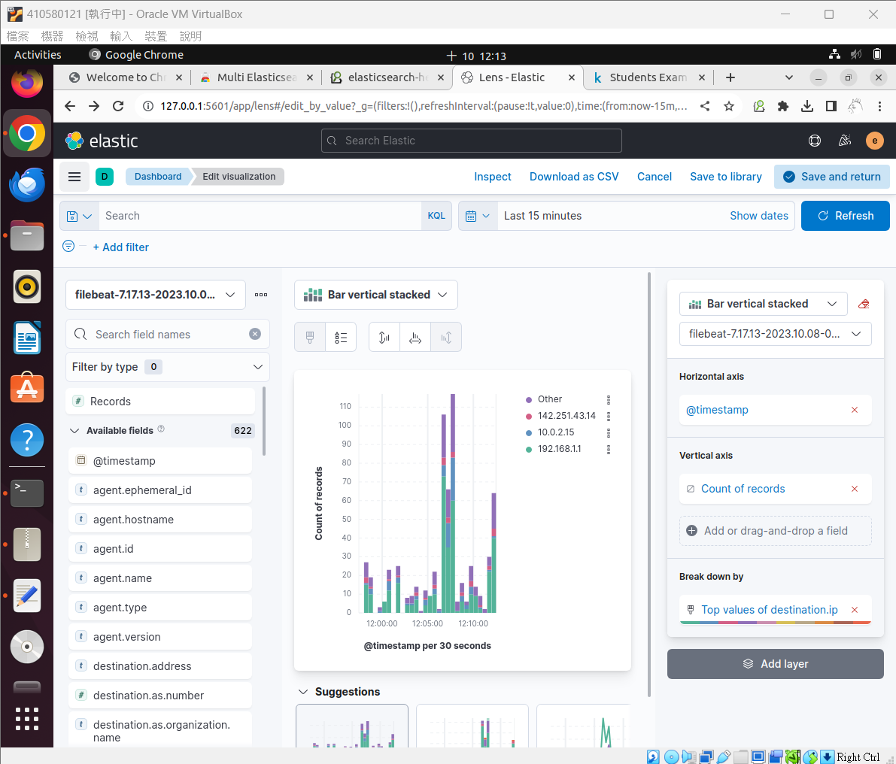

Slide 44
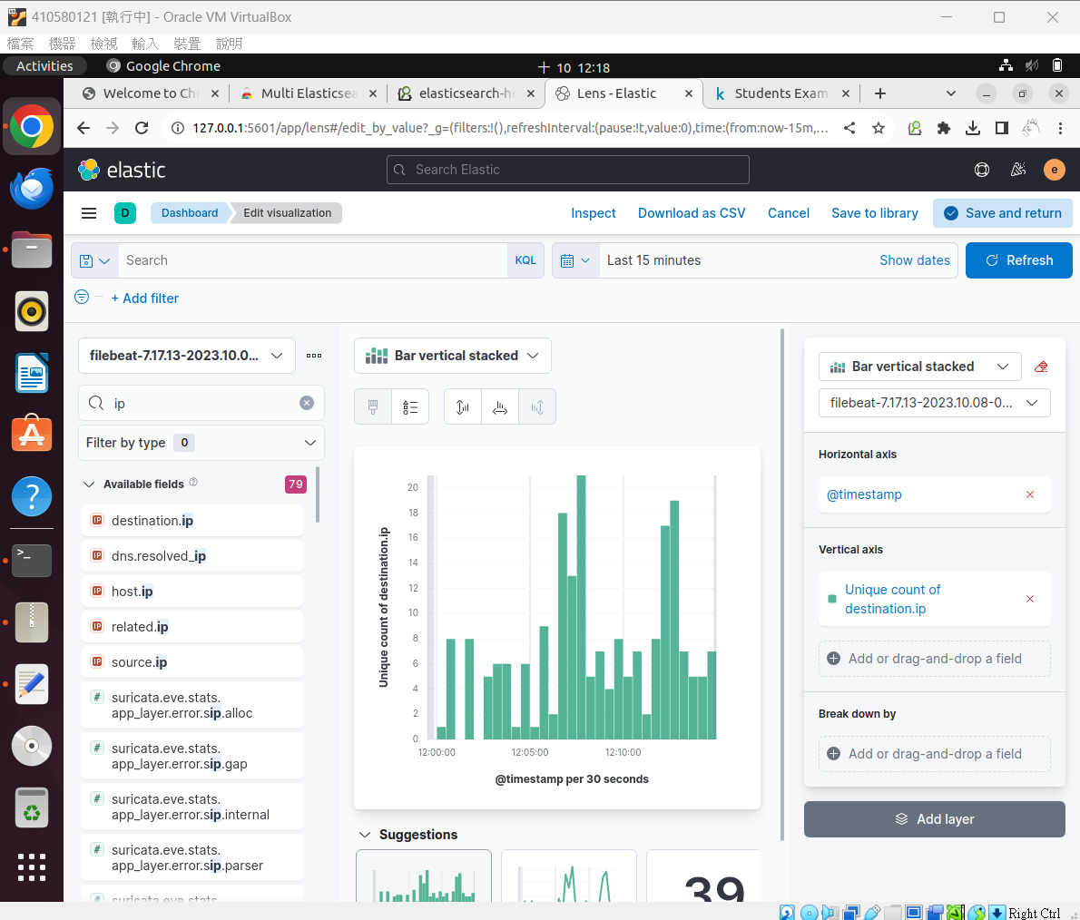

Slide 45
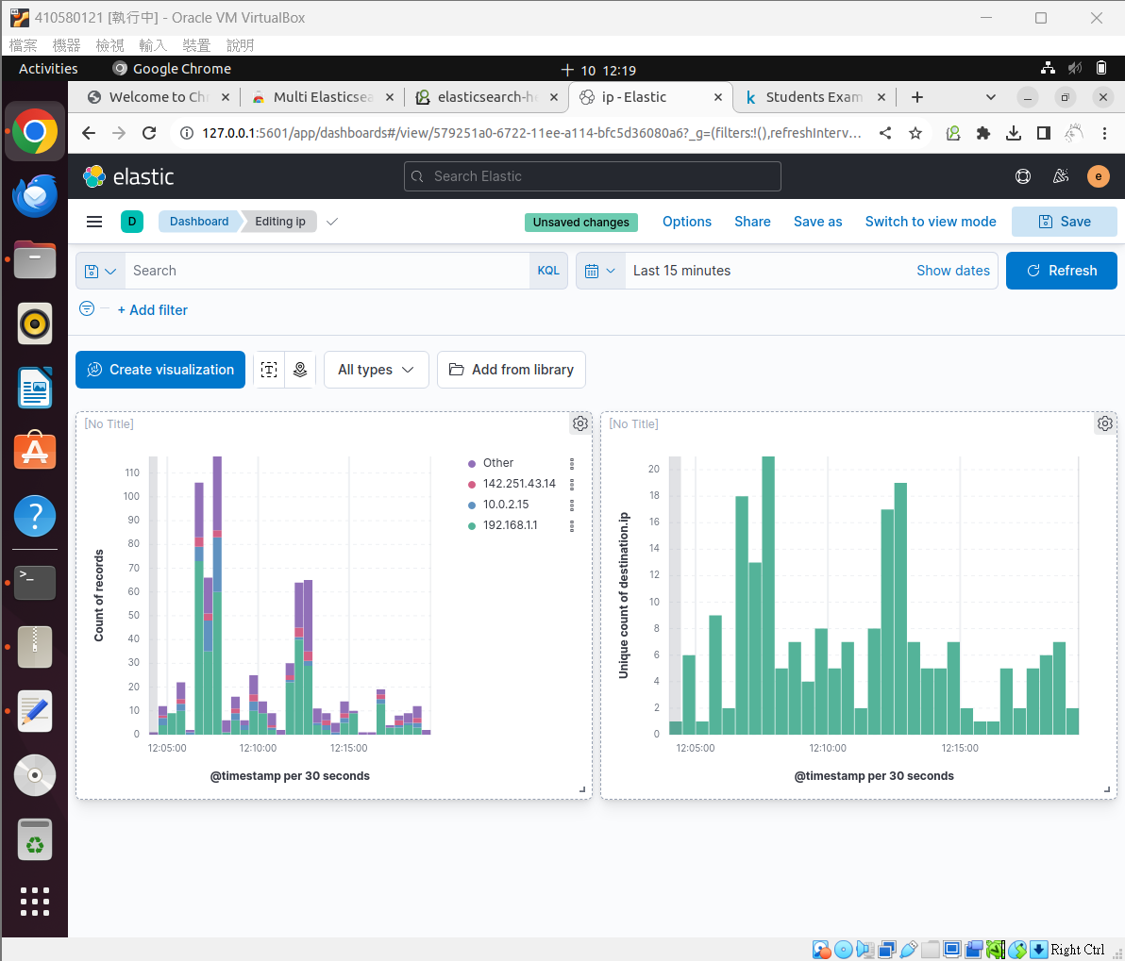

Slide 46
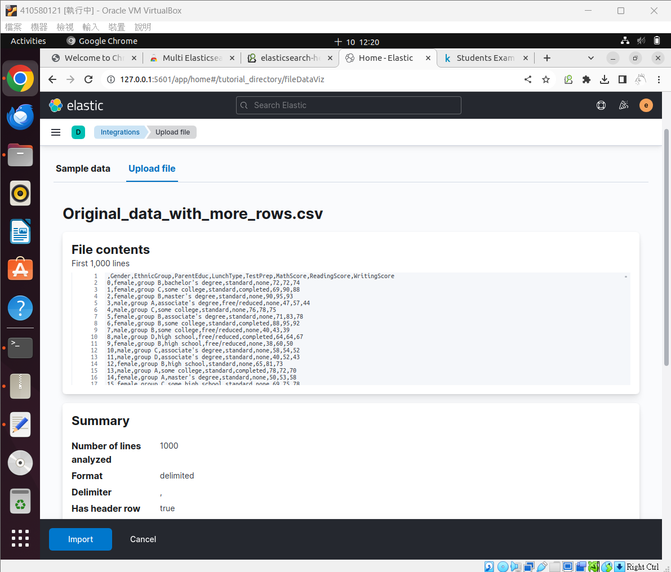
匯入外部資料

Slide 47
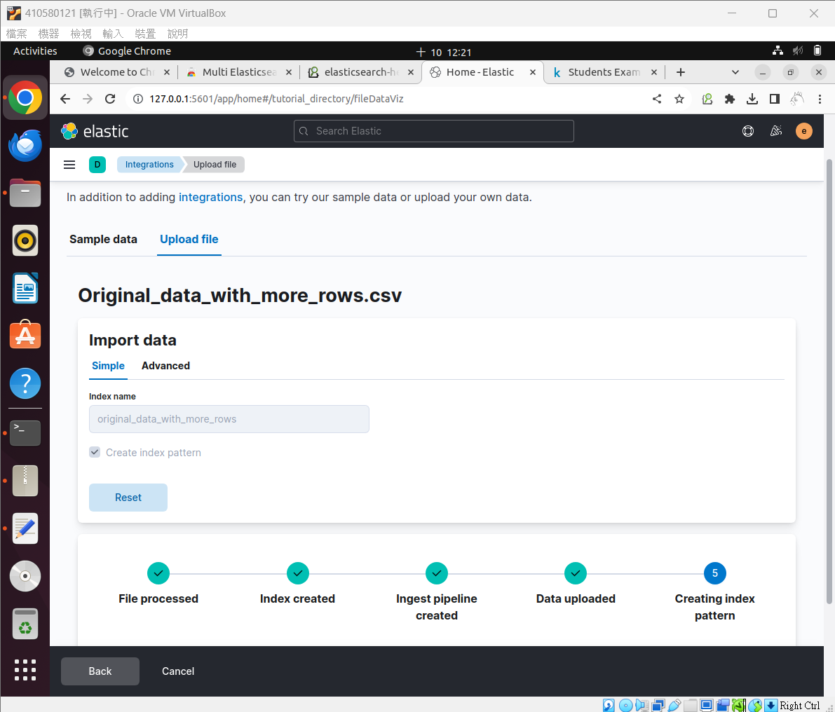

Slide 48
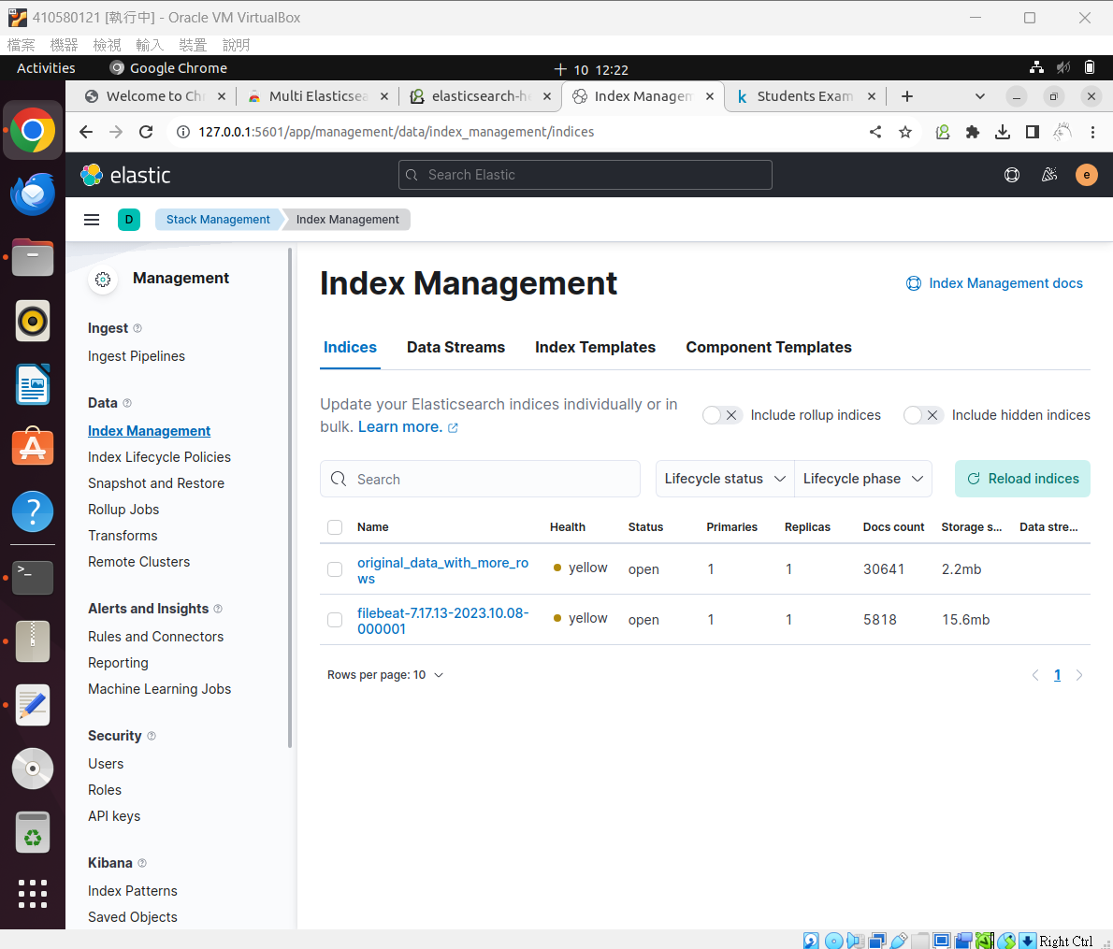

Slide 49
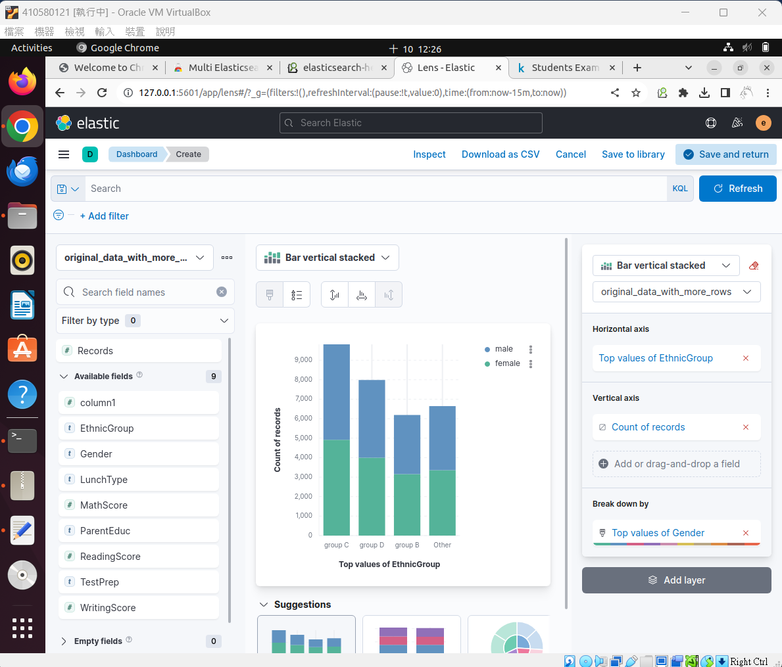

Slide 50
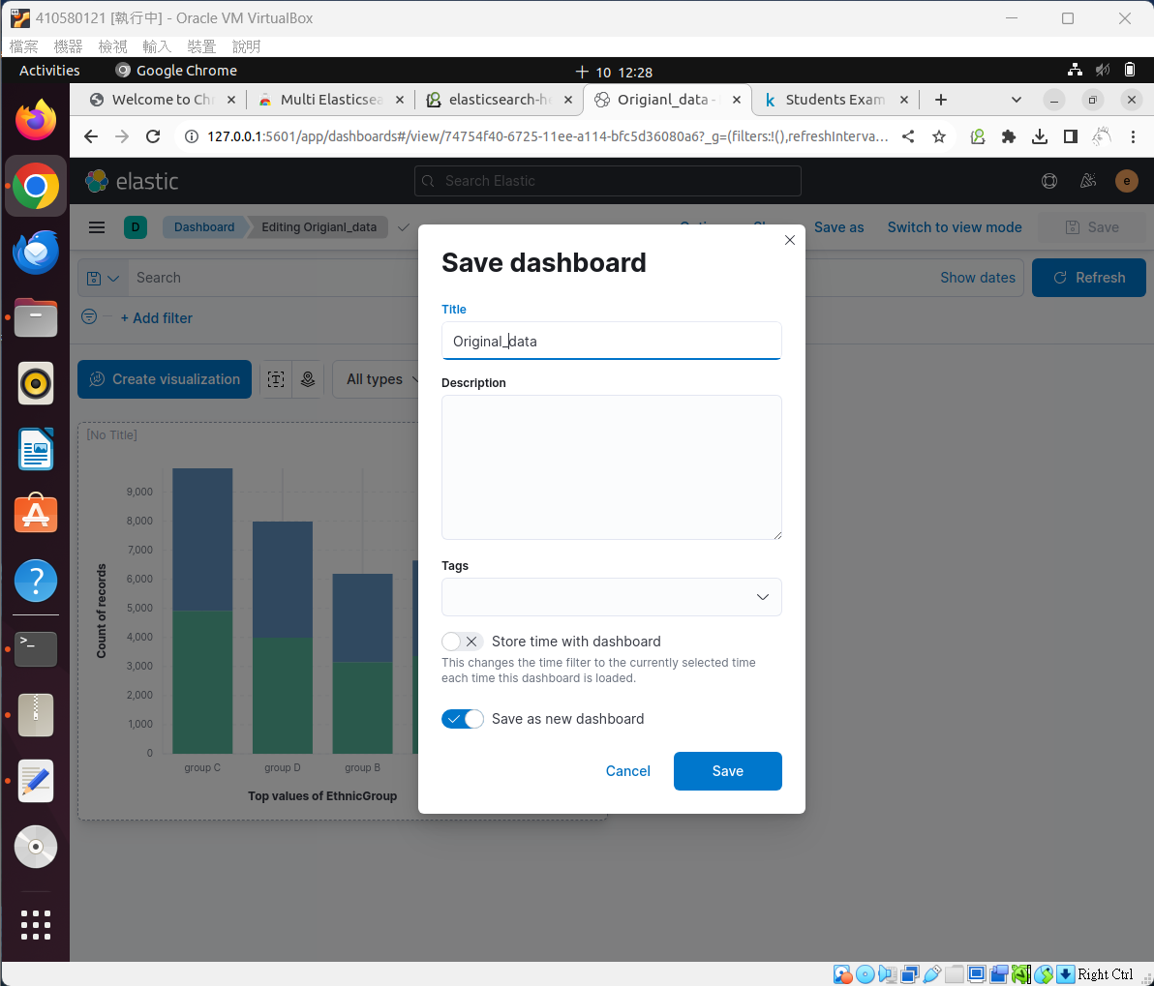

Slide 51
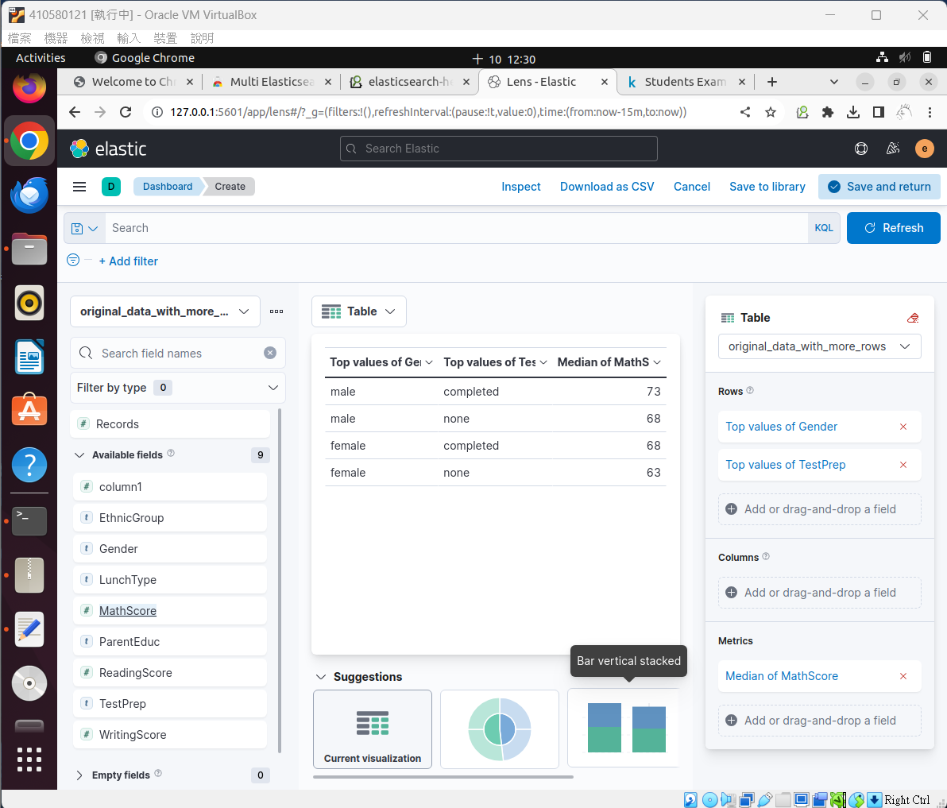

Slide 52


Slide 53


Slide 54


